Slide 1
2. Robot Dynamics
2.1 Newton-Euler formulation
2.2 Lagrange-Euler formulation
2.3 Properties of dynamic models
2.4 Tutorials of dynamics
2.5 Neural network modelling
- 1 -

Slide 2
2. Robot Dynamics
W²H = What, Why, and How
WHAT is robot dynamics?
Find the dynamic equations of motion for a manipulator which deals with the relationship between the
Robot Motion and the Forces/Torques applied externally,
while robot kinematics deals with the relationship between the joint variable space and the position and orientation of the end-effector in the world space.

Slide 3
2. Robot Dynamics
W²H = What, Why, and How
WHY do we want to study robot dynamics?
Robot dynamic equations are used for
i. Simulation and Digital Twin of Robot Dynamics
It is a way of designing prototype robots and testing control strategies without the expenses of working with actual robots (Economical).
ii. Controller Design
Most control design techniques are based on plant model. Moreover, model-based controller is Superior to non-model-based controller.

Slide 4
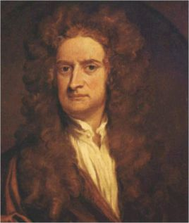
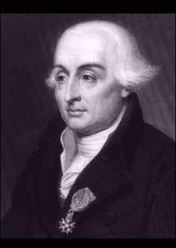
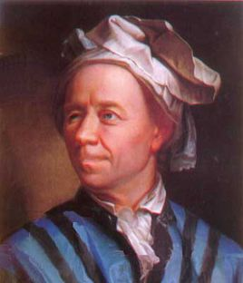
2. Robot Dynamics
W²H = What, Why, and How
HOW to derive robot dynamics?
Two basic methods
Newton - Euler Equation (Formulation)
Lagrange - Euler Equation (Formulation)

Slide 5
2.1 Newton-Euler formulation
Newton - Euler (N-E) Equation
Based on Newtonian mechanics
Forward-backward recursive
Each link of a robot is treated in turn
Lagrange - Euler (L-E) Equation
Based on Lagrangian mechanics
Closed form solution
The system is taken as a whole
Methods 1 and 2 are for providing different insights.
Any other formulations in literature are obtained from these two formulations.

Slide 6
2.1 Newton-Euler formulation
Brief Comparison Between Newton-Euler And Lagrange-Euler Equations
Newton - Euler | Lagrange - Euler
Recursive Form Less Structured No General Property Difficult for Controller Design | Closed Form Well Structured General Properties Exist Suitable for Controller Design

Slide 7
Remarks:
Lagrange-Euler Formulation can be made as efficient as Newton-Euler Formulation.
(Silver, W.M. (1982), “On the equivalence of Lagrangian and Newton-Euler Dynamics for manipulators,” International Journal of Robotics Research, Vol.1, No.2, pp.66-70, Summer)
For controller design and closed-loop stability analysis, a closed-form Lagrangian formulation is preferred.
Any other methods are based on the above two fundamental methods.

Slide 8
2. Robot Dynamics
2.1 Newton-Euler Formulations
2.2 Lagrange-Euler Formulation
2.3 Properties of Dynamic Model
2.4 Dynamics Tutorials
2.5 Neural Network Modelling
- 8 -

Slide 9
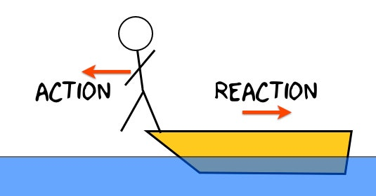
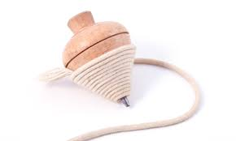
2.1 Newton-Euler formulation
Newton - Euler Formulation
In deriving the equations of motion, Newton Mechanics are also used, by considering each link individually, which state:
Every action has an equal and opposite reaction.
The rate of change of the linear momentum equals the total force applied to the body.
The rate of change of the angular momentum equals the total torque applied to the body.

Slide 10
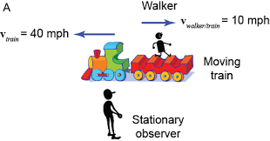
2.1 Newton-Euler formulation
Mapping Review
1. Translation
Note: o'x'y'z' is the Moving Frame (or Rotating Frame later)
- 10 -

Slide 11
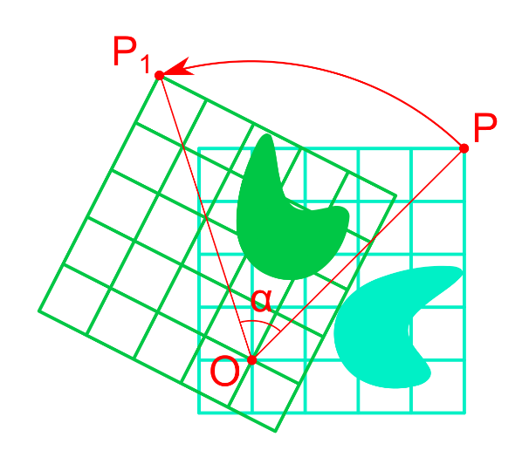
2.1 Newton-Euler formulation
Mapping Review
2. Rotation
Writing the unit vector of frame in terms of frame x y z and stacking them as the columns.

Slide 12
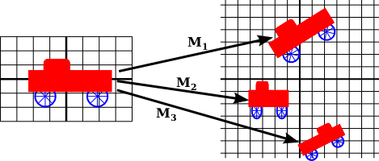
2.1 Newton-Euler formulation
Mapping Review
3. Translation plus

Slide 13
2.1 Newton-Euler formulation
Mapping Review
4. Linear Velocity ( is constant)

Slide 14
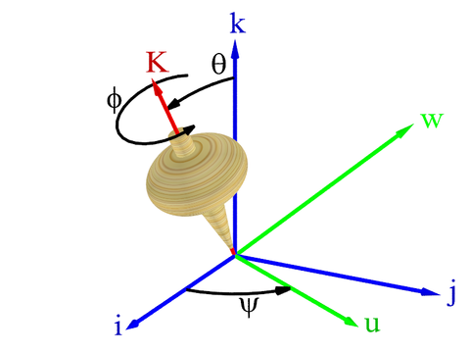
2.1 Newton-Euler formulation
Mapping Review
5. Rotational Velocity

Slide 15
2.1 Newton-Euler formulation
For constant with respect to frame {B}:
For changing with respect to frame {B}:
Simultaneous linear and rotational velocity
Derivation ( )
Derivation ( )
Derivation

Slide 16
2.1 Newton-Euler formulation
Acceleration of a rigid body
Linear Acceleration
If is constant, then
Angular Acceleration
For three frames {A}, {B}, and {C}, rotating angular speeds{ }, { }, then
By differentiating, we have
(2.1.1)

Slide 17
2.1 Newton-Euler formulation
Newton's equation
Euler's equation
Rigid body:
--- acceleration of centre of mass
--- acting at the centre of mass
Rigid body:
--- angular velocity
--- angular acceleration
--- the torque acting on the body
--- the inertia tensor in a frame with its origin located at the centre of mass

Slide 18
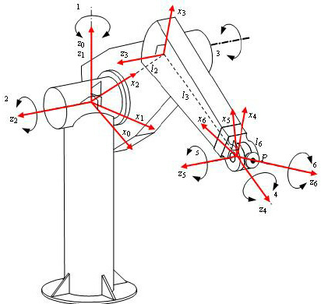
2.1 Newton-Euler formulation
Due to the rotation of
the vector
Due to the
change in
backward
forward
Forward - Backward Algorithm

Slide 19
2.1 Newton-Euler formulation
Forward-Backward Algorithm
Outward iterations i: 0 5
with
If joint (i+1) is Revolute
(2.1.2)
If joint (i+1) is Prismatic
(2.1.3)

Slide 20
2.1 Newton-Euler formulation
Forward-Backward Algorithm
Linear acceleration of the origin of each frame
(2.1.4)
Linear Acceleration of the centre of mass
See Eq. (2.1.1)
(2.1.5)
(2.1.6)
(2.1.7)

Slide 21
2.1 Newton-Euler formulation
Forward-Backward Algorithm
Inward iterations i=6 1
(2.1.8)
(2.1.9)
Torque
(2.1.10)

Slide 22
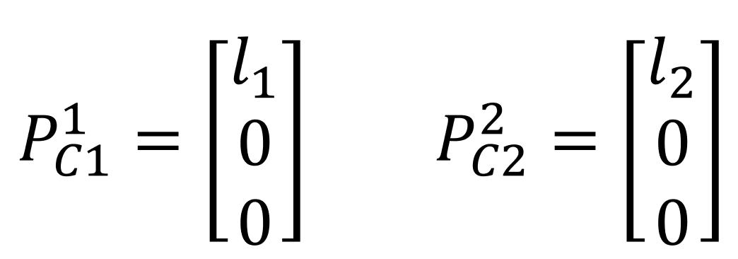
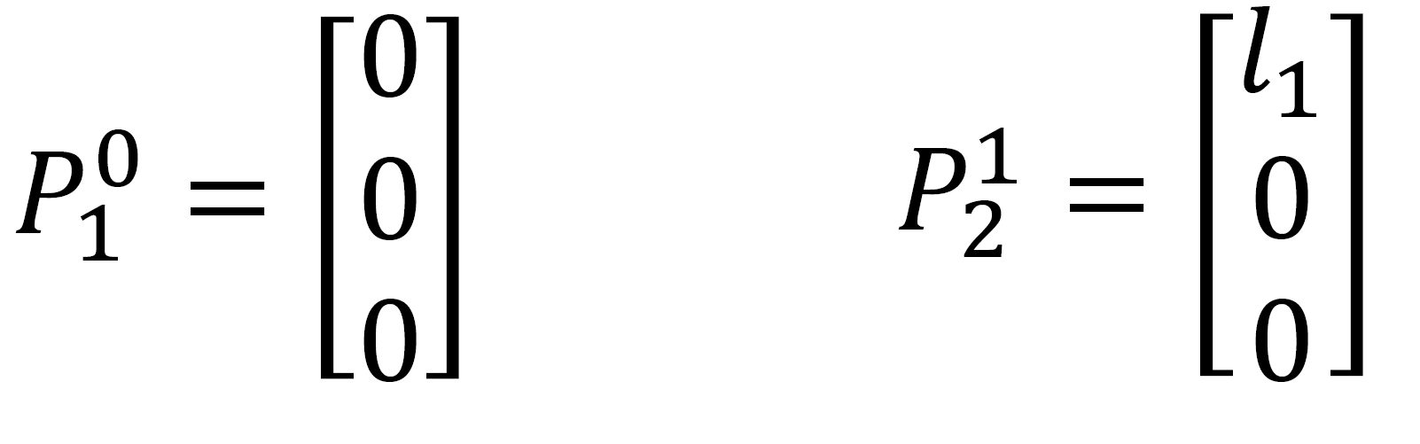




2.1 Newton-Euler formulation
Example 2.1: Derive the dynamic model for the planar two-link manipulator.
Suppose that the robot is under the influence of gravitational acceleration. Assume that the mass of each link is lumped at end of the link.
$$l_{2}$$
$$l_{1}$$
The centre of mass of each link is represented in its coordinate system as
$$l_{2}$$
Each coordinate system is represented under its previous coordinate system as
$$l_{1}$$

Slide 23
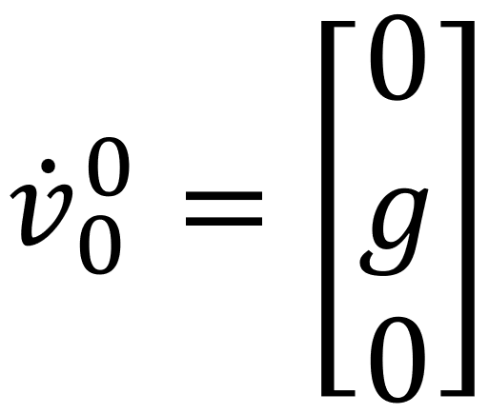
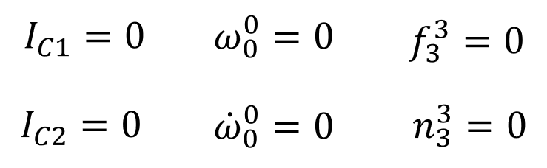
2.1 Newton-Euler formulation
Example 2.1:
Since the robot is in a gravitational environment, the base is subject to gravitational acceleration.
(2.1.11)
The mass of each link is lumped at end of the link. The base cannot be moved ad there is no force at the end of the robot arm.

Slide 24
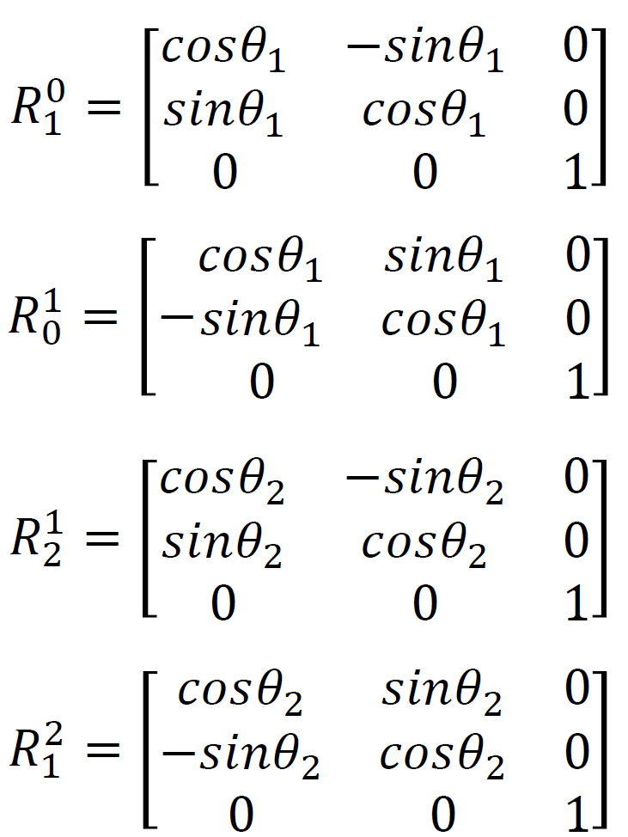
2.1 Newton-Euler formulation
The rotational matrices between the base, link 1 and link 2 are:
Notes:
Test notes

Slide 25
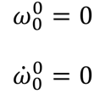
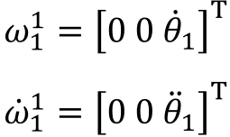

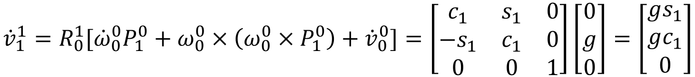
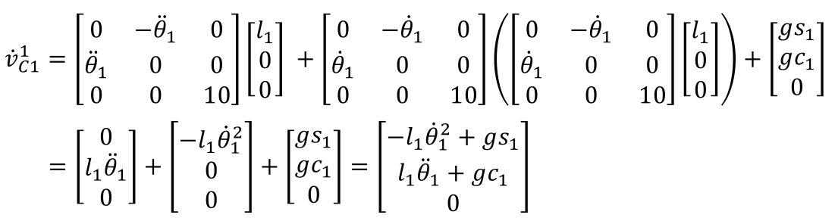


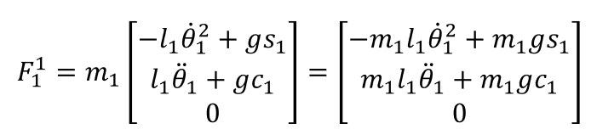


2.1 Newton-Euler formulation
Example 2.1:
Outward iterations: link 1
By Eq. (2.1.4) and (2.1.11), we get
Let
$$c$$
s
See Eq. (2.1.4)-(2.1.7)

Slide 26
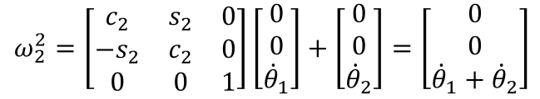
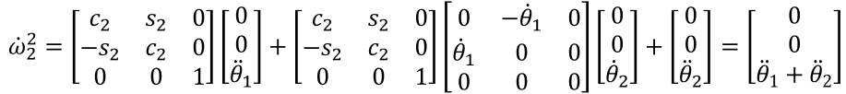
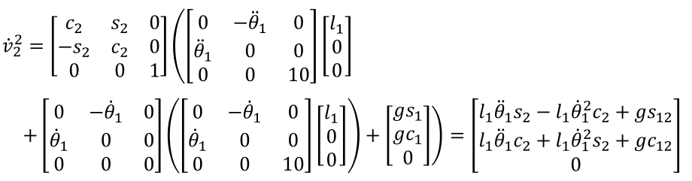
2.1 Newton-Euler formulation
Example 2.1:
Outward iterations: link 2
See Eq. (2.1.2)-(2.1.4)

Slide 27
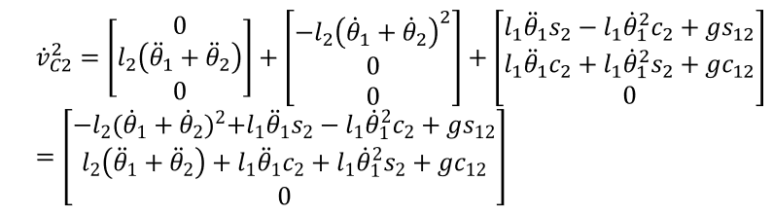
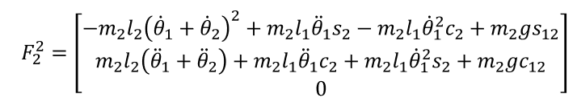

2.1 Newton-Euler formulation
Example 2.1:
Outward iterations: link 2
See Eq. (2.1.5)-(2.1.7)

Slide 28
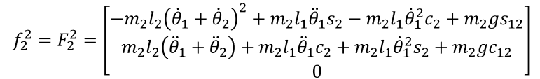
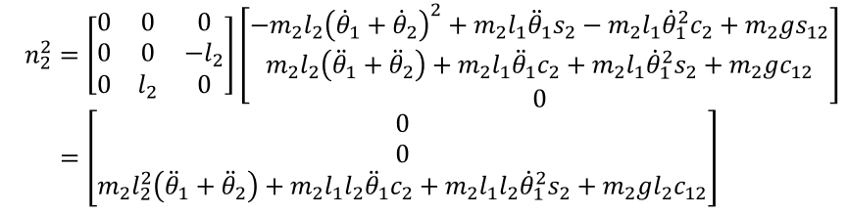
2.1 Newton-Euler formulation
Example 2.1:
Inward iterations: link 2
See Eq. (2.1.8)-(2.1.10)

Slide 29
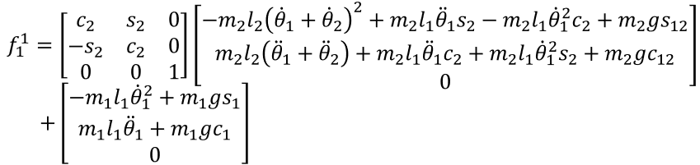
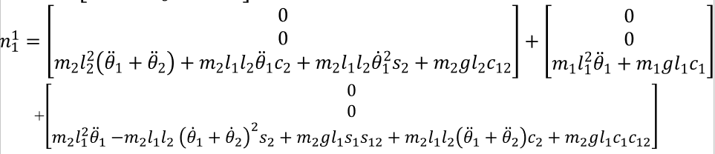
2.1 Newton-Euler formulation
Example 2.1:
Inward iterations: link 1
See Eq. (2.1.8)-(2.1.10)

Slide 30
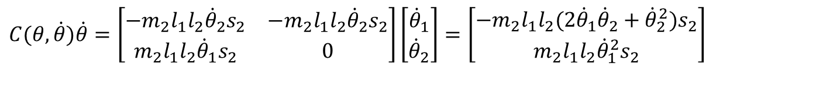
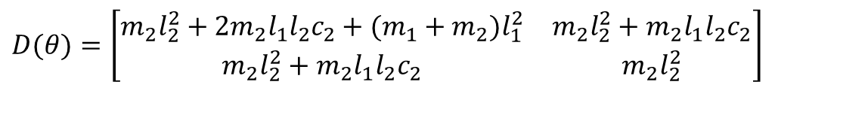

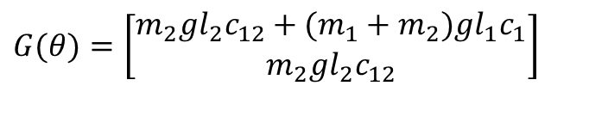
2.1 Newton-Euler formulation
$$D(θ)\ddot{θ}+C(θ,\dot{θ})\dot{θ}+G(θ)=τ$$
$$D(θ)=\left[\begin{matrix}m_{2}l_{2}^{2}+2m_{2}l_{1}l_{2}c_{2}+(m_{1}+m_{2})l_{1}^{2} & m_{2}l_{2}^{2}+m_{2}l_{1}l_{2}c_{2} \\ m_{2}l_{2}^{2}+m_{2}l_{1}l_{2}c_{2} & m_{2}l_{2}^{2}\end{matrix}\right]$$
$$C(θ,\dot{θ})\dot{θ}=\left[\begin{matrix}−m_{2}l_{1}l_{2}{\dot{θ}}_{2}s_{2} & −m_{2}l_{1}l_{2}{\dot{θ}}_{2}s_{2} \\ m_{2}l_{1}l_{2}{\dot{θ}}_{1}s_{2} & 0\end{matrix}\right]\left[\begin{matrix}{\dot{θ}}_{1} \\ {\dot{θ}}_{2}\end{matrix}\right]=\left[\begin{matrix}−m_{2}l_{1}l_{2}(2{\dot{θ}}_{1}{\dot{θ}}_{2}+{\dot{θ}}_{2}^{2})s_{2} \\ m_{2}l_{1}l_{2}{\dot{θ}}_{1}^{2}s_{2}\end{matrix}\right]$$
$$G(θ)=\left[\begin{matrix}m_{2}gl_{2}c_{12}+(m_{1}+m_{2})gl_{1}c_{1} \\ m_{2}gl_{2}c_{12}\end{matrix}\right]$$

